Slide 1
UI/UX Case study-Mobile Banking App Redesign
Day 4-High-Fidelity Wireframes

Slide 2
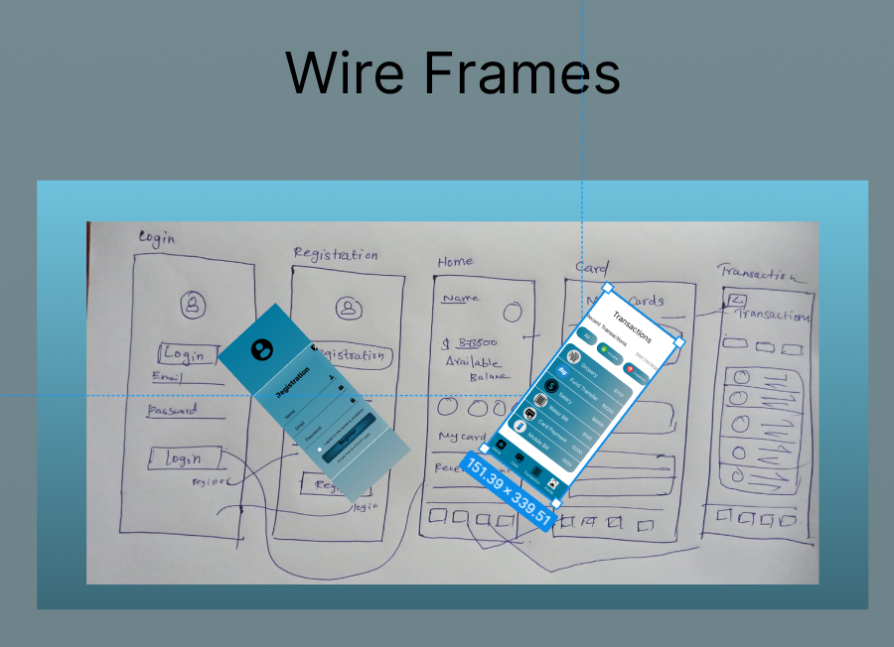
Wireframes Templates

Slide 3
Conclusion
The end of the Day 4,high-fidelity wireframes for the core screens will be developed , an interactive prototype will be created.
The Project link:
https://www.figma.com/design/Qr3UOFZFILShZvOKN4rfOT/Banking-App-Redesign-(Community)?m=auto&t=MFkgnjCgCPRTwiXt-6

